Slide 1
G7 Provider Event
Friday 21st May 2021

Slide 2
https://g7.devon-cornwall.police.uk/media/2855/g7_timeline_short-final.jpg
Notes:
I know the picture is too small to view meaningfully over Teams but you can study at your leisure as the slides will be forwarded on.
The key take away and why it was worth showing here is that it show the full extent of community impacts announced.
Most are concentrated in the days of the actual summit however it does show that there are impacts which will be felt in the days up to and after the main event.

Slide 3
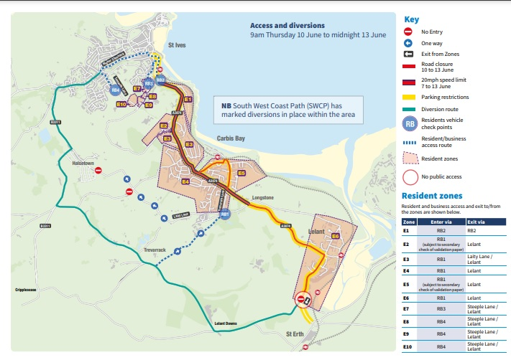
https://g7.devon-cornwall.police.uk/impact/
Notes:
I know the picture is too small to view meaningfully over Teams but you can study at your leisure as the slides will be forwarded on.
The key take away and why it was worth showing here is that it show the full extent of community impacts announced.
Most are concentrated in the days of the actual summit however it does show that there are impacts which will be felt in the days up to and after the main event.

Slide 4
Specific measures announced;
St Ives, Carbis Bay and Lelant
In the St Ives and Carbis Bay area the A3074 (St Ives Road) will be closed to all traffic from 9am on 10 June until 11.59pm on 13 June.
Security barriers and fencing installed from the 4 June and there will be some initial short-term disruption,
The Old Coach Road via Halsetown will be used to provide access to St Ives Town and delays are expected.

Slide 5
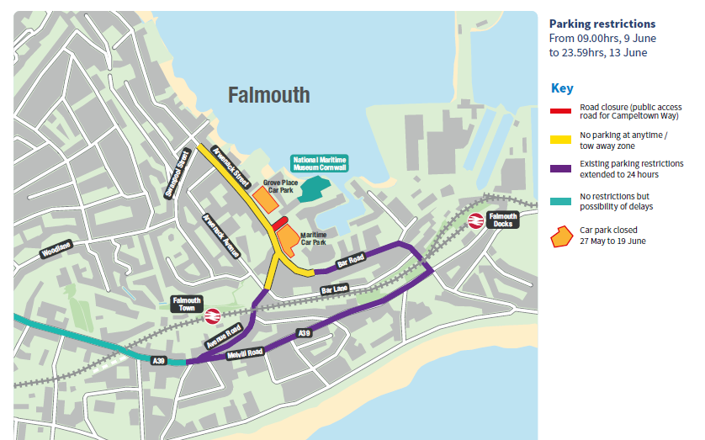
https://g7.devon-cornwall.police.uk/impact/
Notes:
I know the picture is too small to view meaningfully over Teams but you can study at your leisure as the slides will be forwarded on.
The key take away and why it was worth showing here is that it show the full extent of community impacts announced.
Most are concentrated in the days of the actual summit however it does show that there are impacts which will be felt in the days up to and after the main event.

Slide 6
Specific measures announced (2);
Falmouth and Newquay;
In Falmouth, where the Maritime Museum at Event Square will be used as the media centre for the G7 Summit;
Grove Place and Maritime car parks will be closed between 27 May and 19 June.
Campbeltown Way will be closed to traffic between 27 May and 19 June. The car park in Church Street will be closed for pay and display 10 to 13 June
Around Cornwall Airport Newquay - number of road closures and parking restriction orders in place around the airport for the duration of the event, beginning at 6pm on 9 June, and ending on 11.59pm on 13 June.
Businesses within the perimeter and in the immediate vicinity of Cornwall Newquay Airport will be contacted shortly by the Cabinet Office with specific identification requirement instructions.

Slide 7
Access to secured areas - what we know now
Restricted areas in St Ives and Falmouth will require residents/business workers to provide two forms of current identification linked to their home or business address in order to gain access by vehicles to those homes or businesses.
Council tax bill,
utility bill,
bank statement (within the last three months) or
driving licence.
Delivery drivers/Service providers (including Care Workers and charity volunteers) seeking entry to restricted areas will need to provide proof of manifest / order confirmation to the address that they are seeking to access along with their personal company ID.
Pedestrian access restricted in immediate vicinity of key areas. People will be subject to security checks. Only residents will be allowed.
Notes:
This is the area where we are getting most queries and will continue to seek clarification where needed, specifically for what would need to be carried/shown in order to access these area for workers.

Slide 8
G7 Summit preparations – what you should already be doing?
Start delivery confidence assessments (RAG ratings) of your runs.
Consider the different types of care, and
the risks for each of your care packages – e.g. standard/end of life packages
Review and update your contingency arrangements, specifically around alternative modes of transport between your clients and constructing ‘what if’ scenarios.
Hold discussions with your clients/families around the timings of their care provision during the period – get them involved in contingency planning!
Keep updated as specific traffic measures are announced in the weeks before the event starts. These may affect your travel times or the routes your carers may usually take (see next slide).

Slide 9
Q & A
What specific questions do you have?
We may not know the answer but can put those questions to the relevant people.
Some things are changing/being updated regularly which is why we have signposted the relevant sources.
The D&C FAQ is being regularly updated. https://g7.devon-cornwall.police.uk/faq/ There will be further opportunities (see later) for engagement where questions can be put to the police and other partners.
Notes:
From The Current Police FAQ;
Q - Do I have to go through the checkpoints if I am a pedestrian and will I need to carry ID with me?
A - Pedestrians will be able to move around freely, however it is highly recommended that you always have identification with you. In particular, residents in the immediate vicinity of venues will be subjected to additional ID checks.
Q - What forms of identification (ID) are acceptable?
A - Any official forms of identification with a photograph such as a driving licence, passport or ID work pass are acceptable photo ID. In terms of proof for the location you are attending, any utility bill or other documentation from a formal body such as the DVLA will be sufficient. This should be no more than 3 months old and can be shown via a smartphone.
Q - Do I need photo identification as well as proof of address?
A - For the fastest access to restricted areas, you will require photo ID as well as proof of address. We recommend keeping these items on you at all times during this period. There may be substantial delays whilst officers confirm identify if these two types of ID are not available.
Q - What should I do if I forget my identification?
A - This will delay access if entering checkpoints whilst officers try to establish and confirm your identity before either permitting you through once confirmed, or by waiting for someone to escort you through to confirm your destination.

Slide 10
Escalation during the event
The West Locality Commissioning Team will be co-located with the Locality Care and Support Team leading up to the event.
Care and Support issues as usual via the access team;
Ring 0300 1234 131 between 8.45am and 5.15pm Monday to Thursday and 8.45am to 4.45pm on Fridays. Out of Hours - ring 0300 1234 131
Issues with access to secure area;
Sarah Scoltock - West Area - sarah.scoltock@cornwall.gov.uk - 01872 323251
Sarah Scrivener - Central Area - sarah.scrivener@cornwall.gov.uk - 07967 146 015
Ben Seamarks - North and East Area - ben.seamarks@cornwall.gov.uk - 01872 322927
Additional support from Care Home Support Nurses (see next slide) for G& in affected area

Slide 11
Additional support for Care Homes
Louisa Forbes and her team will be supporting care homes in the G7 affected area.
Care Home Support Nurses
07894 804647 - Please call to request input.
We are available 7 days - 9 to 5
Louisa Forbes, Consultant Nurse for Care Homes and Community louisa.forbes@nhs.net
Lesley Rowe, Senior Nurse Lesley.Rowe4@nhs.net
Paul Kimpton, Senior Nurse Paul.Kimpton1@nhs.net
“We offer virtual clinical advice and support in managing deterioration in Care Homes.
This can also include care home visits where appropriate. We also support transitions of care out of hospital.”

Slide 12
How can I keep updated?
There is the dedicated police website https://g7.devon-cornwall.police.uk/ including a useful FAQ
You can sign up for regular updates and community alerts https://alerts.dc.police.uk/
There are facebook live events (recorded) which you can find on the local police site https://www.facebook.com/HayleAndStIvesPolice These will be regularly held and will allow discussion of new developments as they are communicated.
Council News about the G7 and Cornwall https://www.cornwall.gov.uk/council-news/g7-cornwall-2021/ and we will continue to use the Jon Price communications.
There is also a dedicated website 2021 G7 Summit – UK Presidency (g7uk.org) and Government G7 news can be found on Twitter @G7 and Instagram.

Slide 13
A further opportunities for engagement;
(1) You are invited to the next Community Network Meeting which will include the latest information about plans for the G7. This an Open Meeting and is for any Cllr, Businesses, Community or Voluntary Groups and Residents.
Monday 24th of May from 7pm until 8.30pm and will be held on Teams. Click here to join the meeting
Vanessa Luckwell, Community Link Officer, Hayle and St Ives Network area
Vanessa.luckwell@cornwall.gov.uk
(2) Stakeholder briefing on G7 for health services carers / care workers who may be affected by transport disruption proposed for 27 May 10 – 11.30 – details to follow.
It will be hosted by Police who will give a presentation on traffic impacts and a representative from the council and cabinet office to answer questions alongside the police.
Notes:
Community Network Meeting;
This will include information specifically about this area including, the road closure plan, access arrangements, public transport and more.
A large section of this meeting will be questions and answers, and we aim to have people at the meeting who are able to answer those questions.

Slide 14
Thank you / Meur ras
If you have any questions or comments
contractsadults@cornwall.gov.uk

