Slide 1


Better Information Sharing
Cornwall Partners in Care - 14th September 2018
Keith Strahan, Registered Social Worker, NHS Digital
keith.strahan@nhs.net

Slide 2
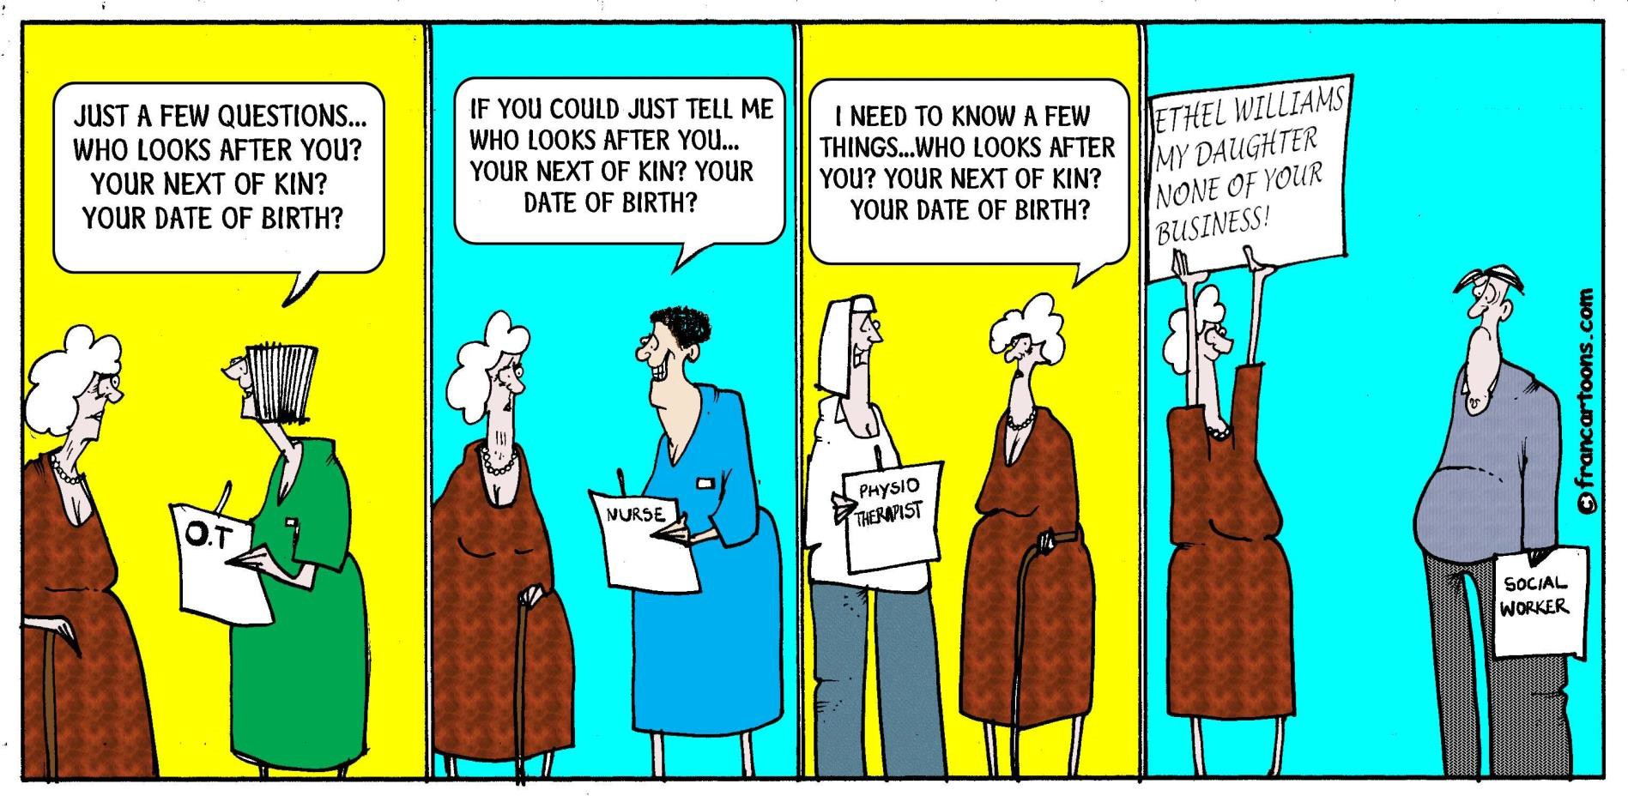
Meet Ethel…

Slide 3
Contents
The Social Care Sector
Information Sharing?
Information Governance, Cyber Security and the Data Security and Protection Toolkit
Digital Opportunities, including NHSmail
The NHS Digital, Social Care Programme

Slide 4

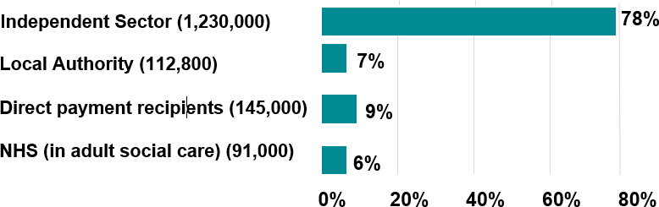
The Adult Social Care Sector - England
Estimated Number of Adult Social Care jobs by employer type
Registered Nurses were one of the only jobs to see a significant decrease (although there
are still over 40,000 in the sector).
Skills for Care’s The state of the adult social care sector and workforce in England 2017’

Slide 5
































Optometrist
Dietician
Some of the information flows with Care Homes...
Assisted Technology:
(e.g. Community Equipment Services, Telecare, Blue Badge)
Family/ Friends
Adult Social Care:
Public and private domiciliary services
Local Authority: Adult Social Care Commissioning
Voluntary Sector
Ambulances
Dentist
Falls Service
Person/Carer
Care Home
GP
Transport Service
Safeguarding vulnerable adults
Other Local Authority
Prisons
Acute (e.g. urgent
care, outpatients, admissions)
Mental Health Organisations
Social Worker: Duty Team
Podiatrist
Hospice/End of Life
CCG:
Commissioning
Community Nurse
Occupational Therapists
Social Work Case Manager
Pharmacy
Police
Physio
Single Point Assessment
Care Navigator/ Multidisciplinary team link
Local Authority: Housing

Slide 6
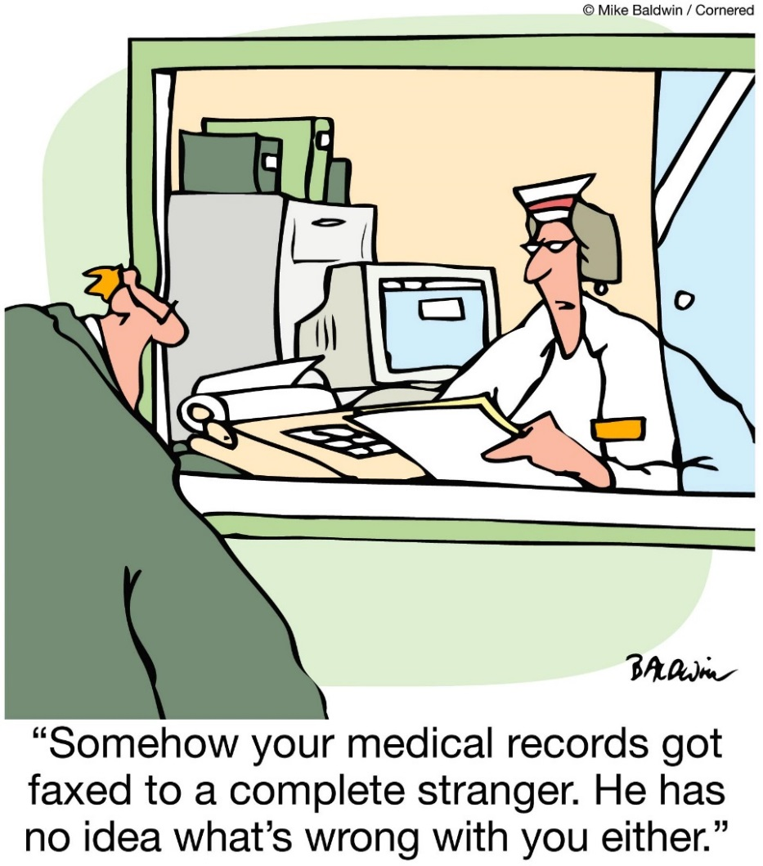
Information Sharing?
Despite pockets of good practice, information to care providers is in the main posted or faxed…

Slide 7
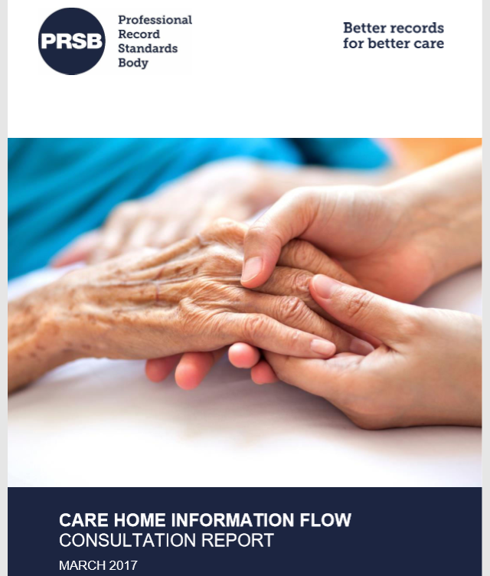
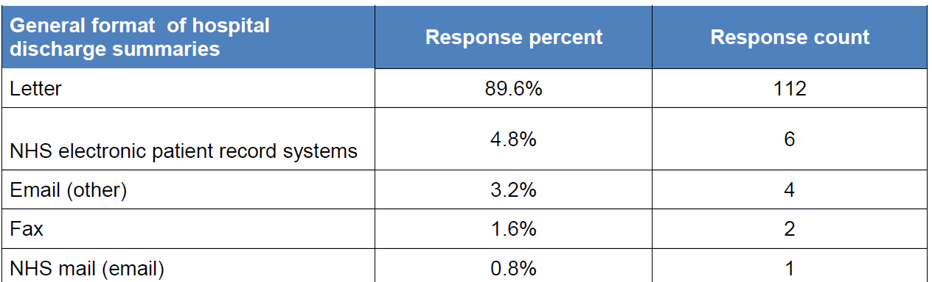
PRSB Report: Care Homes Information Flows

Slide 8

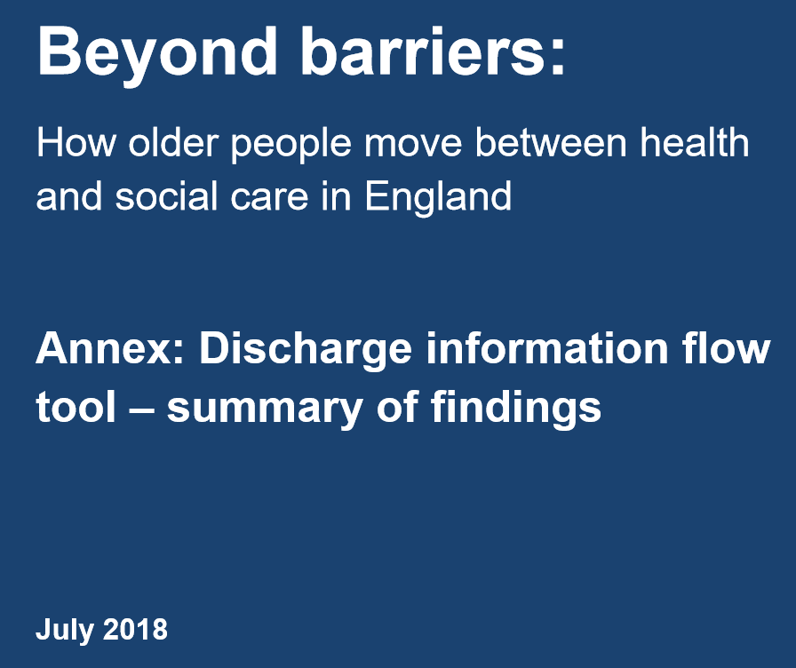
Information
Sharing? https://www.cqc.org.uk/publications/themed-work/beyond-barriers-how-older-people-move-between-health-care-england

Slide 9
Beyond Barriers - Discharge information
“People are frequently discharged from hospital to their home without accurate or sufficient information. We heard about people returning home or being moved to a new home only to get unsafe care and/or get readmitted to hospital because a lack of information”
Providers not routinely involved in a joined-up discharge.
Variability in how often social care providers receive discharge summaries.
The content, accuracy and timeliness of the discharge information received also are inconsistent.
Responses from Registered Managers of Domiciliary Care agencies indicate their services are the most overlooked.
Multiple respondents spoke of not being informed of when people would be discharged.
Medication and unsafe discharges issues resulted in people being readmitted to hospital.
Poor planning and information sharing can undermine.
A lack of joined-up planning can result in duplication of work and unnecessary chasing for information.
Digital information sharing between health and social care systems appears to be largely absent.

Slide 10

Information Governance and Cyber Security: Background
July 2016 - National Data Guardian Review of data security, consent and opt-out
Conclusions regarding the old Information Governance Toolkit:
Limited attention to cyber security
Difficult for small organisations
Often seen as a lengthy tick box exercise
Health oriented e.g. terminology
Dame Fiona Caldicott National Data Guardian
Recommended that its ‘10 Data Standards’ should be
implemented.
These now provide the basis for the ‘Data Security and
Protection Toolkit’ which replaced the IG Toolkit in April 18.

Slide 11
The Data Security and Protection Toolkit
The Care Provider Alliance has been working with NHS Digital to make the new Toolkit more straightforward, relevant and proportionate for Care Providers.

Slide 12
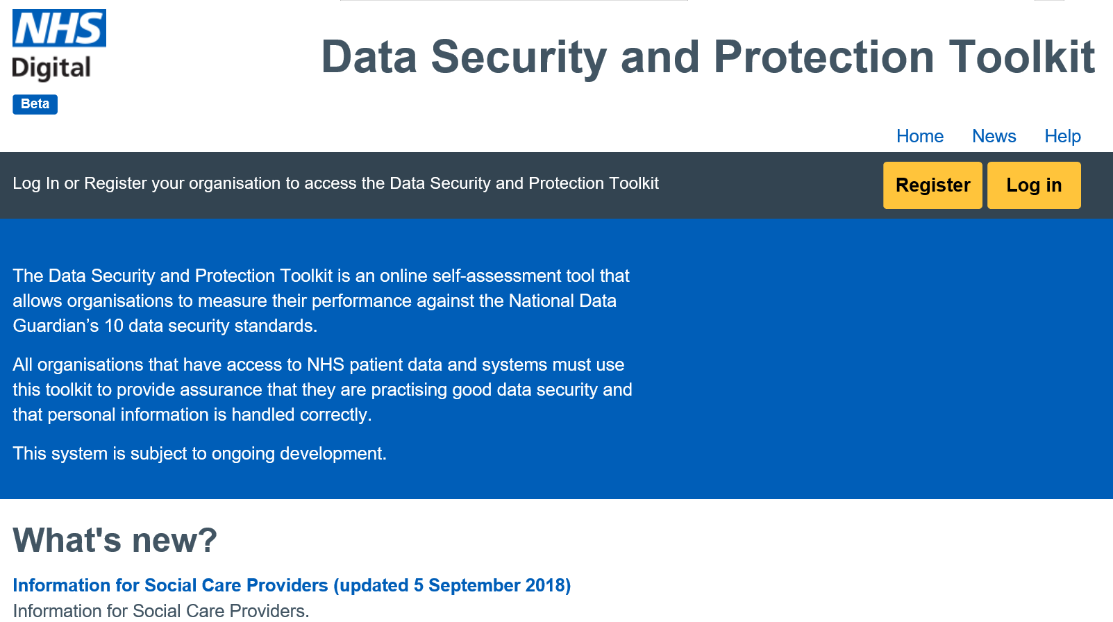
The Data Security and Protection Toolkit The Data Security and Protection Toolkit is an online self-assessment tool for data security.

Slide 13

The Data Security and Protection Toolkit
It is recommended that all social care providers complete the Toolkit as they will hold, process or share personal data.
Crucially, when an organisation has reached the appropriate level of compliance with the Toolkit it will enable them to assure themselves that they have met the requirements of the General Data Protection Regulation (GDPR).
Care Quality Commission ‘well led’ inspections Key Lines of Enquiry (KLOEs) include data security. Using the DSPT will be helpful in demonstrating compliance to the CQC.

Slide 14
The Data Security and Protection Toolkit:
Information for Social Care Providers - June 18
Provides an introduction to the Data Security and Protection Toolkit and written with Care Providers and the NHS Digital Social Care Programme
https://www.dsptoolkit.nhs.uk/News/33
Including
How to register
The steps social care organisations need to take
What support is available and
An explanation of the levels of the Data Security and Protection Toolkit

Slide 15
The Data Security and Protection Toolkit
Extra time has been allowed for social care organisations to be fully compliant with
the required standards as it is understood that for many this will be a new process.
There is a new “Entry” level. It will enable social care providers to meet minimum
legal requirements and have access to NHSmail.
It is then expected that social care providers move on to achieve ‘Standards Met’.
The ‘Standards Met’ level demonstrates that an organisation is -
Compliant with the expected standards for health and social care to hold, process or share personal data.
Ready to participate in a wide range of secure health and care digital solutions for
the benefit of all.

Slide 16
The Levels in the Data Security and Protection Toolkit
Name | Description
Entry Level | Time-limited level (subject to review) for social care providers. Evidence items for critical legal requirements are being met; but some expected mandatory requirements have not been met. (https://www.dsptoolkit.nhs.uk/Help/32) Allows access to NHSmail.
Standards Met | Evidence items for all mandatory expected requirements have been met. Access to NHSmail, other secure national digital solutions, e.g. Summary Care Records, and potentially local digital information sharing solutions.
★ Standards Exceeded | Evidence items for all mandatory expected requirements have been met. The organisation has external cyber security accreditation. Evidence of best practice.
❒ Critical Standards Not Met | Evidence items for critical legal requirements have not been met by the organisation. No access to information sharing tools e.g. NHSmail.

Slide 17
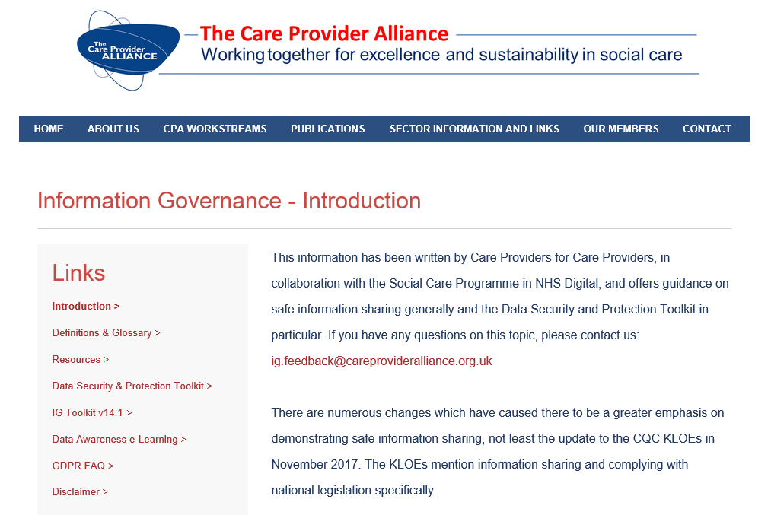
Guidance for Care Providers for the Data Security and Protection Toolkit
Toolkit guidance for Care Providers is now available

Slide 18
Guidance for Care Providers for the Data Security and Protection Toolkit
Includes:
An Introduction to Cyber Security
Guide for Registered Managers / Guide for Staff
Toolkit Tips/‘Big Picture’ Guides Guidance to accompany assertions in the new toolkit and overall view of 10 Data Standards
‘How to Guide’ for Entry Level Now available on the CPA website: http://www.careprovideralliance.org.uk/data-security-and-protection-toolkit.html (you need to scroll down a little bit).
‘How to Guide’ for Standards Met Level In Draft, available October 18

Slide 19
Data Security and Protection Toolkit – Support
Video conferences on using the toolkit. Run regularly, please see the news page for updates https://www.dsptoolkit.nhs.uk/News/10
Next for Social Care:
Friday 28 September 2018 (12.30-13.30) – Dom Care
Wednesday 3 October 2018 (13.00-14.00) - Social Care
Thursday 18 October 2018 (12.30-13.30) – Dom Care
Friday 19 October 2018 (12.30-13.30) - Social Care

Slide 20
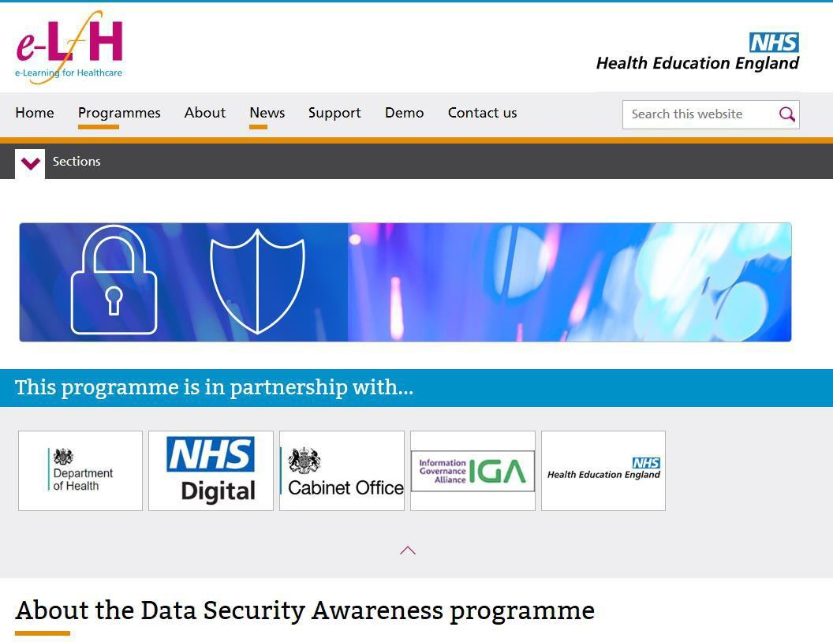
Data Security and Protection Training
NHS Digital, in conjunction with Health Education England is developing Data Security Awareness Training
This training is not mandatory for social care providers but is free and a good resource to use to train staff.
The Level One training can provide staff with a good understanding of information governance, data security and responsibilities under national legislation.
This will also satisfy basic training requirements in the Data Security and Protection Toolkit.
21

Slide 21
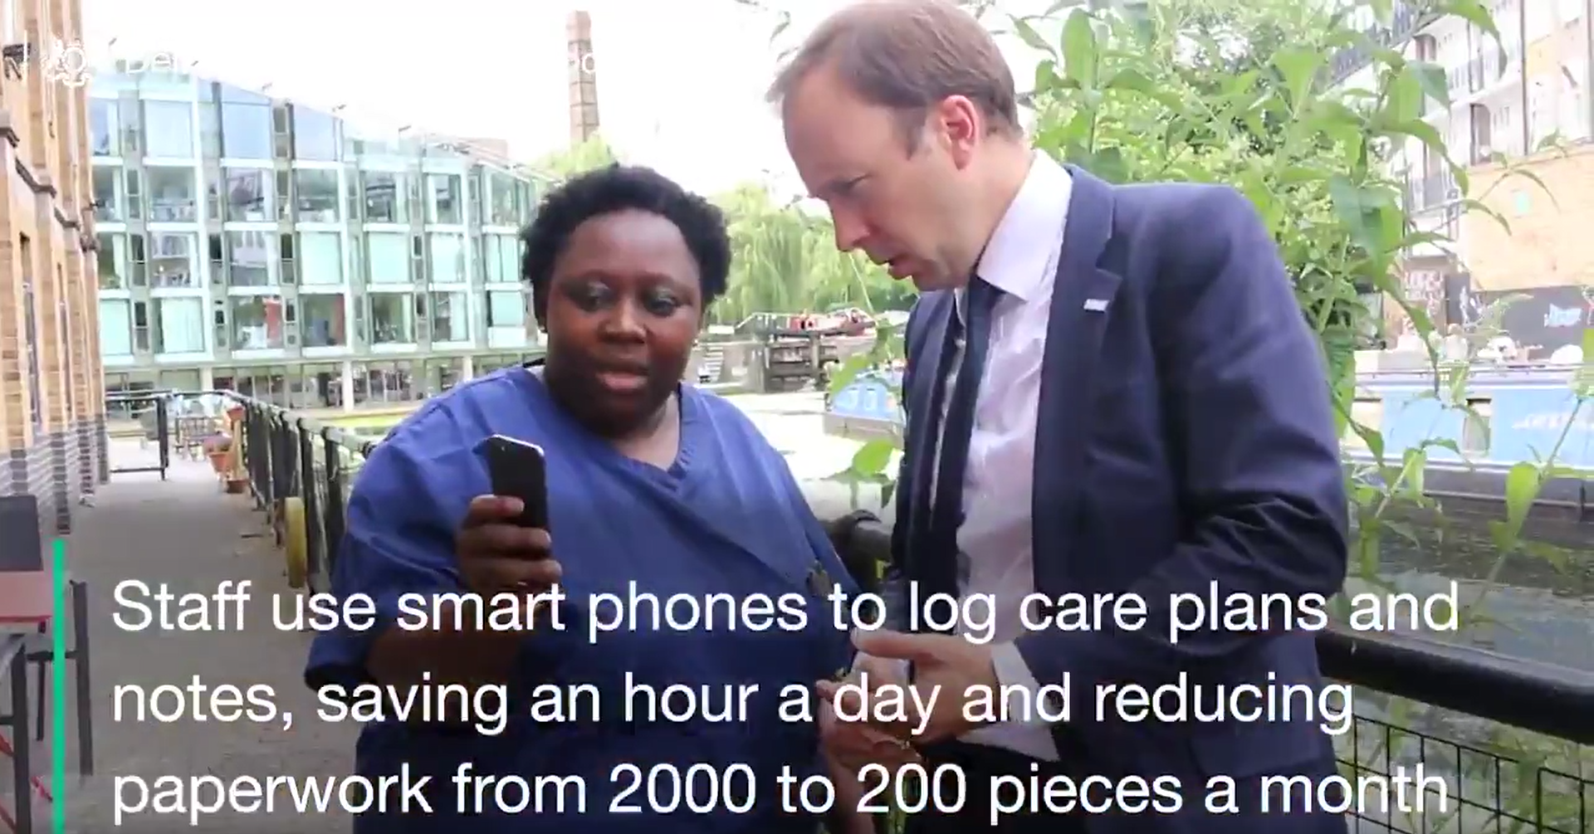
Digital Opportunities: Matt Hancock: Secretary of State for Health and Social Care visiting Bridgeside Lodge Care Home – July 18

Slide 22
Digital Opportunities
Being part of Local Health and Care Integration Plans
  Building on good practice in the sector e.g. personalised care planning, digital record keeping, etc.
Using Secure email e.g. the national offer of NHSmail
  Sharing information across organisational and geographical boundaries.
Accessing ‘Health’ record
- For example, Summary Care Records a national GP summary with over 55.2 million (96%) patient records. Proof of Concepts will be taking place with Care Homes and Domiciliary Care this year. Also potential to access GP Systems, Hospital systems, etc.
Learning lessons from elsewhere
- Community Pharmacy already have access NHSmail and Summary Care Records.

Slide 23
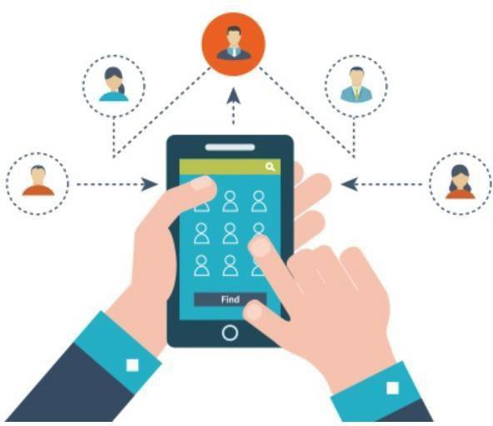
NHSmail
NHSmail is a centrally funded, secure
email service available on the internet.
It supports collaborative working across health and care by the secure sharing of personal, identifiable and sensitive information.
Available NOW to all Care Providers (after formally completing Toolkit).
Not just ‘email to a desktop’ but Mobile Services, Directory, Skype for Business, links to Office 365 as standard; top up services available (paid locally).
National helpdesk – support available 365 days, 24/7 on 0333 200 1133, or via email at helpdesk@nhs.net.
NHSmail Care Home Case Studies

Slide 24
Current use of NHSmail
>1.3M Accounts on the Platform | Clinically Approved Nationally approved for clinical use
>600M Average number of emails per month | 100% Service availability over last 18 months | >7,500 Individual organisations

Slide 25
Joining NHSmail
There are three routes to join NHSmail:-
Local Sponsorship
(CCG or CSU provides Local Administrator service)
Self-Sponsorship
(Normally for large Providers)
National Administration Service A new, centrally funded, online registration portal, likely to be main route for providers. For Care Homes at present, Domiciliary Care use being investigated. https://portal.nhs.net/Registration#/careprovider

Slide 26

NHSmail - Frequently Asked Questions
How many accounts can an organisation have?
Normally 1 shared account and up to 10 named
user accounts
What is a user account and shared account?
User account for named individual e.g.
windy.miller@nhs.net
Generic account for each home e.g.
trumptongreen.carehomecamberwick@nhs.net
(Access only via named account)
Where should I send any enquiries about NHSmail?
feedback@nhs.net

Slide 27
Summary Care Records
Summary Care Records (SCR) Proof of Concepts will be taking place in Care Homes and Domiciliary Care in 18/19.
The aim ultimately is for SCR to be available to all Care Providers in a similar way to NHSmail (also after formally completing the Toolkit).
Summary Care Records as a minimum contain allergies, adverse reactions and medication information.
GP practices now have capability to enrich SCRs with a set of additional information, with the person’s consent.
Patient view also is on the way…
SCRs with additional information include:
Reason for medication
Significant medical history (past and present)
Anticipatory care information (such as information about the management of long term conditions)
Communication preferences
End of life care information
Immunisations

Slide 28
NHS Digital: Social Care Programme
The Social Care Programme is taking a sector-led approach, building on the work already undertaken with the Toolkit, NHSmail and SCR.
Six projects so far designed to stimulate and demonstrate what is possible with the social care sector in the short to medium-term.
Focus on innovators and early adopters, exploiting existing technology, not developing new services
For Example
Assessment, Discharge and Withdrawal Notices (formal notifications under the Care Act)
Funding for seven local authorities to digitise statutory elements of the discharge process between health and local authorities.
Social Care Digital Innovation Programme
Funding for 12 local authorities to support innovative uses of digital technology in the design and delivery of adult social care.

Slide 29
NHS Digital: Social Care Programme (continued)
Social Care Provider Support and Engagement
To develop a sector-owned and managed support for care providers building on work already undertaken by the programme. Procurement underway.
Demonstrators – Health into Social Care (including Care Providers)
Develop digital products and services to transfer information from clinical into social care settings e.g. medical discharge summary. Demonstrators to announced shortly.
Demonstrators – Social Care into Health (including Care Providers)
Investigating what information currently flows from adult social care into health, and what is needed. Demonstrators to announced shortly.
Predictive Analytics
Explore and demonstrate the use of predictive analytics to predict or prevent long-term social care need. Demonstrators to announced shortly.
Questions scp.general@nhs.net

Slide 30
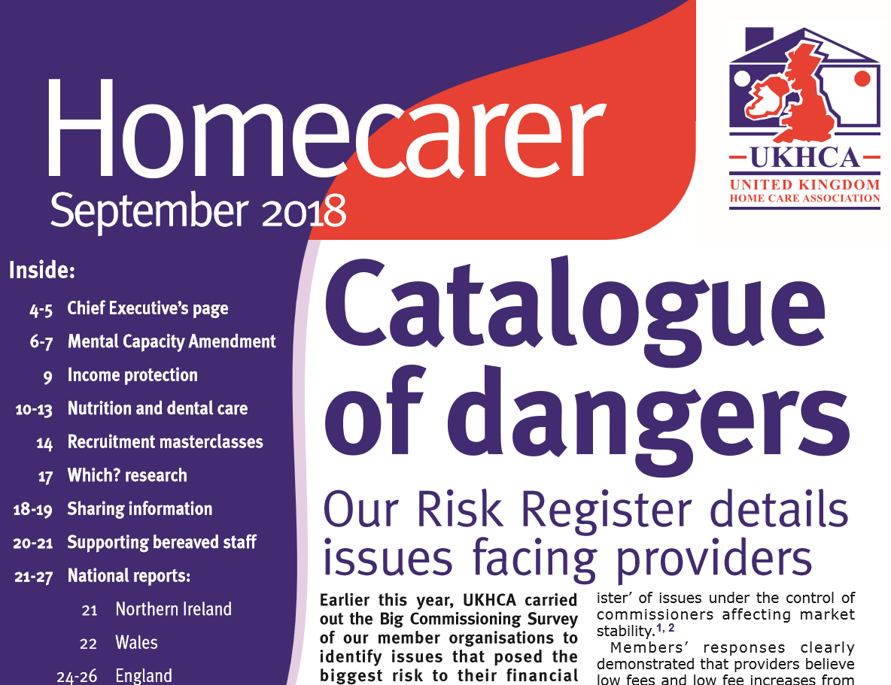
UKHCA Homecarer Newsletter – September 18
This Newsletter has just been published and contains an article (pages 18-19) which includes much of what been mentioned in this presentation.
The Newsletter can be found here: https://www.ukhca.co.uk/homecarer.aspx

Slide 31

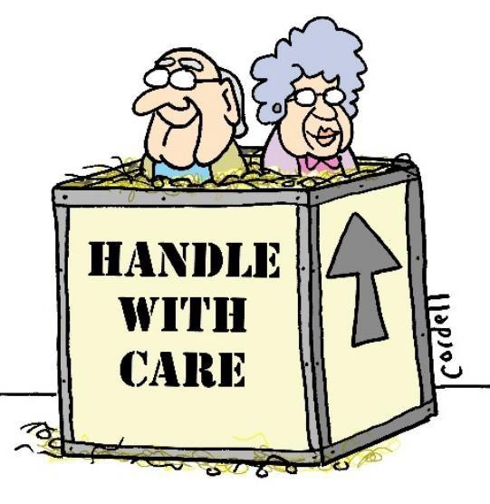

Many Thanks
keith.strahan@nhs.net

Slide 32
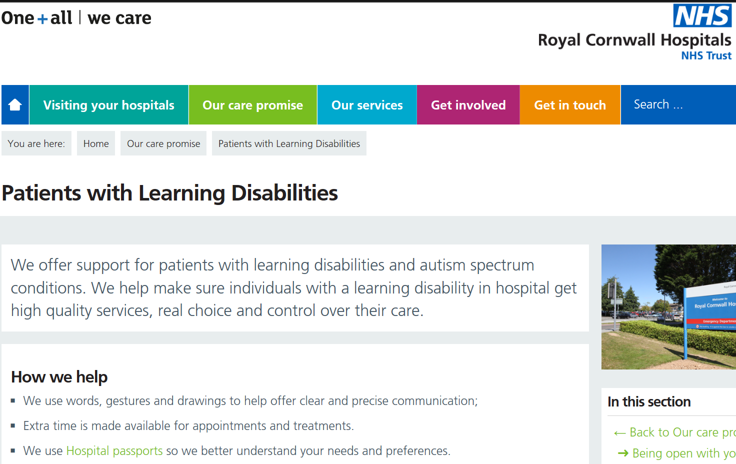
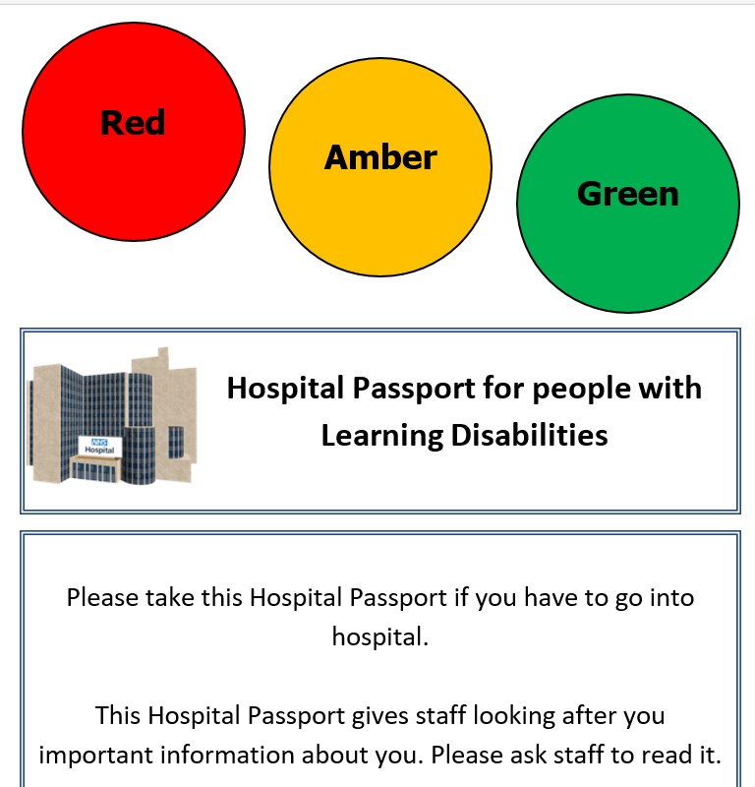
Care/Hospital Passports

Slide 33

Care/Hospital ‘Passports’ - Background
All too frequently, people feel overwhelmed with the amount of information and the number of professionals with whom they come into contact.
Some people also have significant communication issues and detailing their story can be difficult and frustrating.
On occasions, lack of understanding by staff has led to significant harm.
Victoria’s Story
https://www.mencap.org.uk/advice-and-support/health/our-health-guides

Slide 34
Care/Hospital ‘Passports’
Owned by the individual, Care/Hospital ‘Passports’ have been developed to support people with complex/profound needs; including learning disabilities and dementia.
They also help provide staff with immediate and important information for safe and appropriate care, as well as promoting a positive experience for the person.
Examples of when they are used include:
  Admission to hospital for any planned or unplanned assessment;
  Discharge from hospital;
  Attendance at outpatient appointments and
  For many other significant appointments and meetings not related to health

Slide 35
Formatting of ‘Passports’
In the main, paper-based ‘Passports’ are currently the norm with the passports remaining with the individual and their carer
e.g. unpaid relative/friend, parent if a child.
In some areas, editable PDFs are used.
In a few localities, the carers/parents are encouraged to email a much shorter version of the ‘passport’ (almost a minimum data set) to the hospital before the person is admitted.

Slide 36
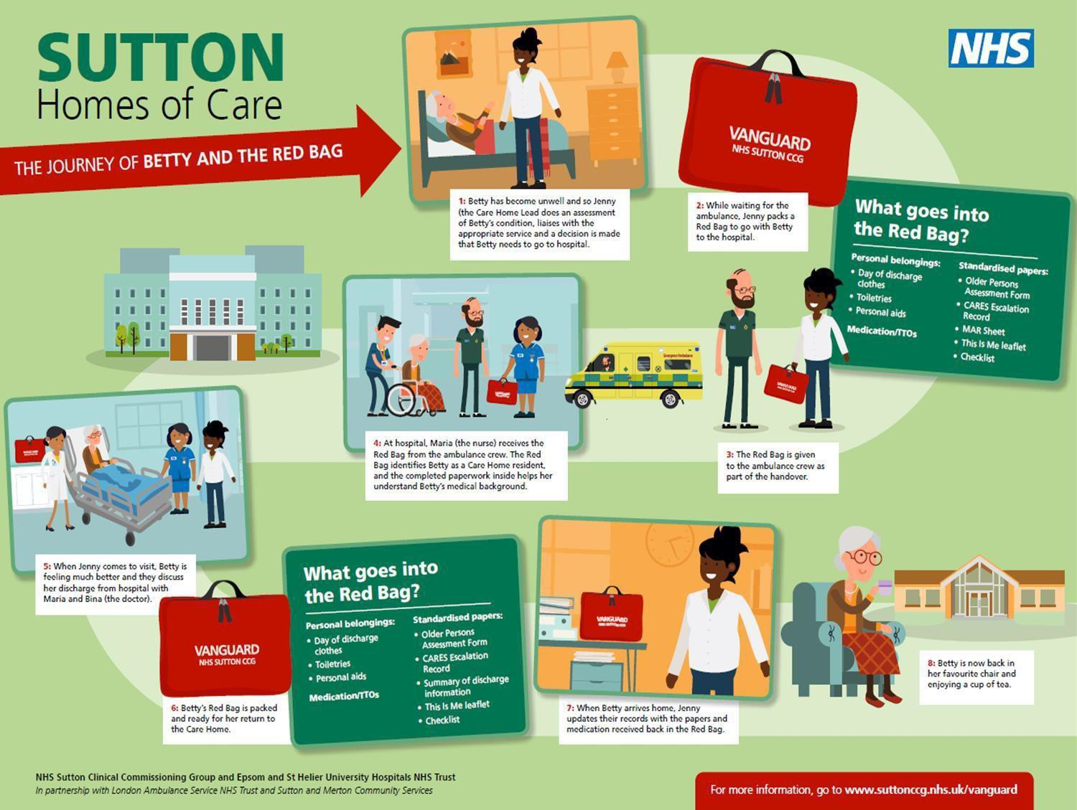
Integrated Hospital Transfer Pathway: The Sutton Vanguard “Red Bag” Initiative

Slide 37
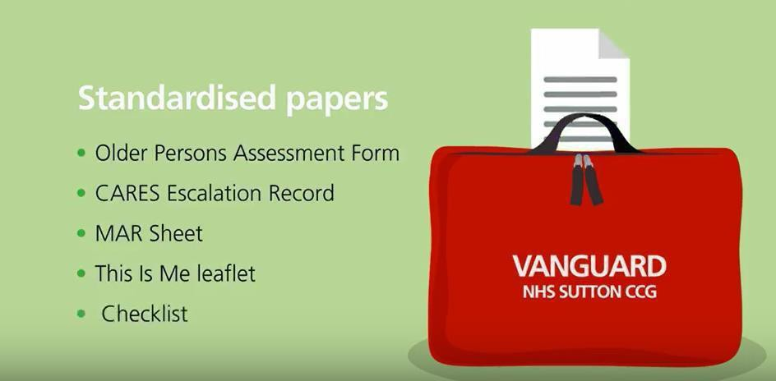
Better Information Sharing - The Sutton Vanguard “Red Bag” Initiative https://www.england.nhs.uk/publication/redbag/
A type of ‘Care/Hospital Passport’

Slide 38
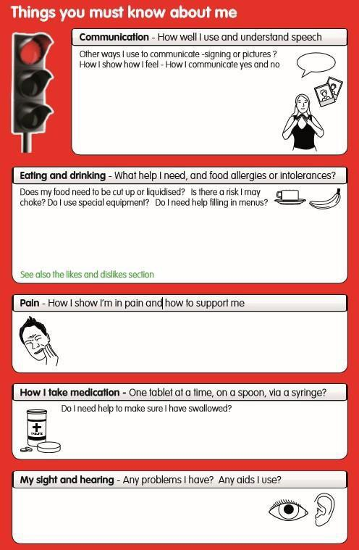
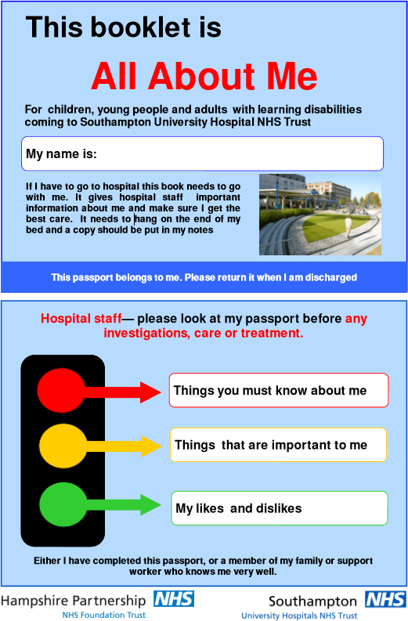



Care/Hospital ‘Passports’

Slide 39
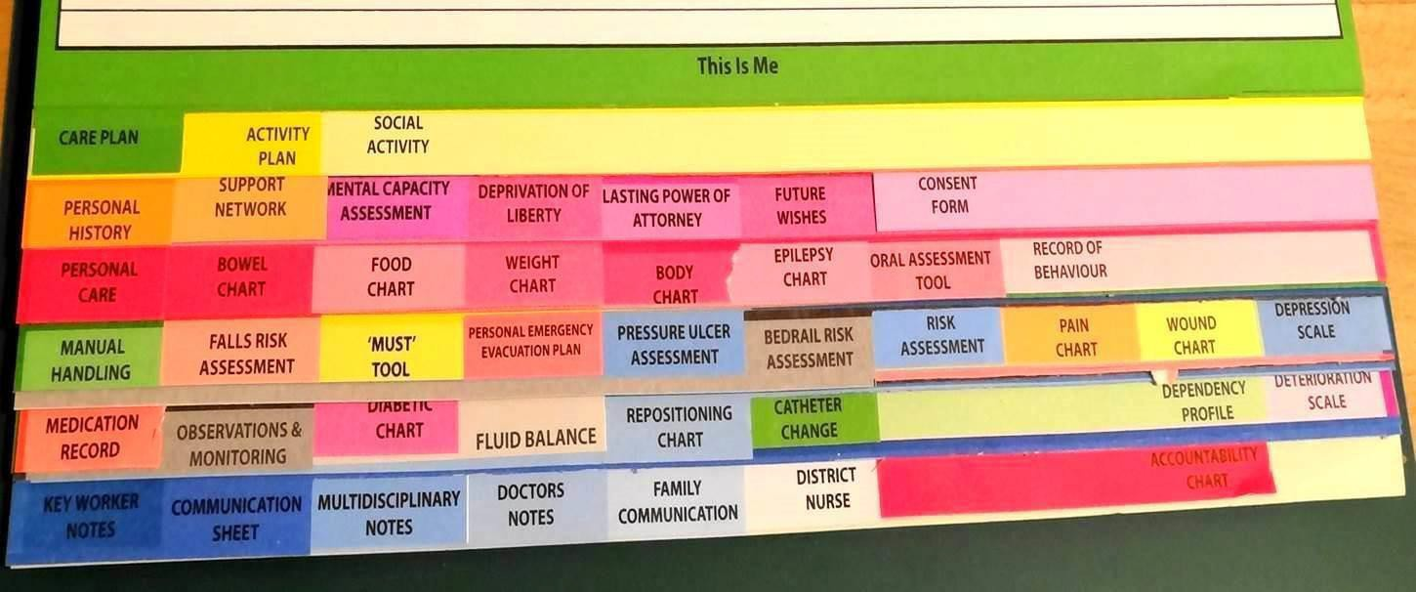
SO LIKE THIS
BUT DIGITAL…HOW?
(Thanks to STANDEX forsharing)

Slide 40
“Reasonable Adjustments”
NHS England have commissioned development of a national reasonable adjustment flag to indicate the potential adjustments to care for patients under the Equality Act (2010)
Includes people with learning disability, physical/sensory disability and other relevant conditions (dementia, cancer, HIV etc). Potentially applies to 20% of people.
The lack of provision of reasonable adjustments has been cited as a significant cause for the premature mortality of patients with learning disability
It is proposed that the “flag” will be stored nationally on the NHS Spine, as flags will be created and accessed by multiple care providers, in multiple care settings.
Piloting of the solution in Summary Care Records viewer during winter 2018/19.
Feedback from pilot to inform future development and national rollout. It is expected that in the longer term, all clinical systems will be integrated with the national flag.
The role of passports and relationship with reasonable adjustments will be explored.

Slide 41
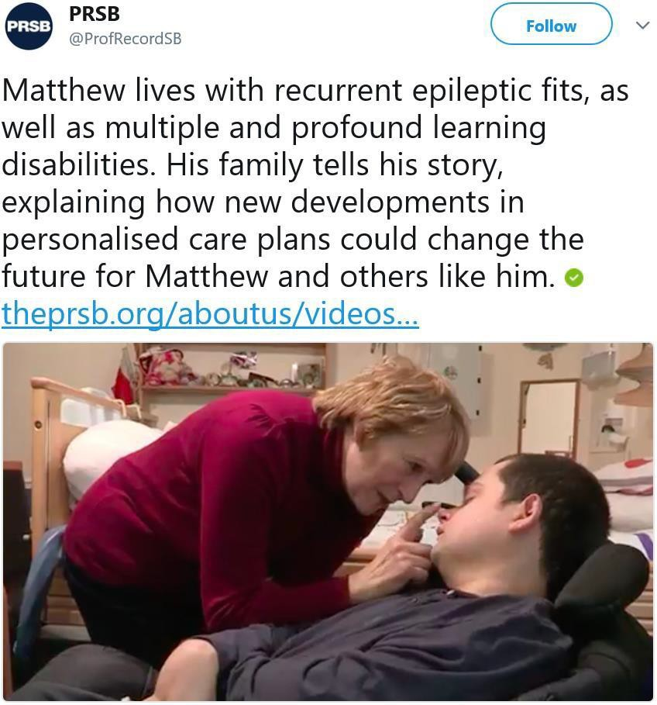


Matthew…
https://theprsb.org/aboutus/videos-2/

Slide 42
‘About Me’
In the Digital Care and Support Planning Standard (out for endorsement) from the Professional Records Standards Body (PRSB) an ‘About Me’ heading is prominent.
It is described as, ‘proportionate information’ which ‘should always be at the forefront
of each plan’ (please see below from the final document).
About Me
About Me | This is a record of the things that an individual feels it is important to communicate about their needs, strengths, values and preferences, etc. to others providing support and care.
Supported to write this by | Where relevant, this is a record of name, relationship/role and contact details of the person who supported the individual to write this section e.g. carer, family member, advocate, professional.
Date | This is a record of the date that this information was last updated.

Slide 43
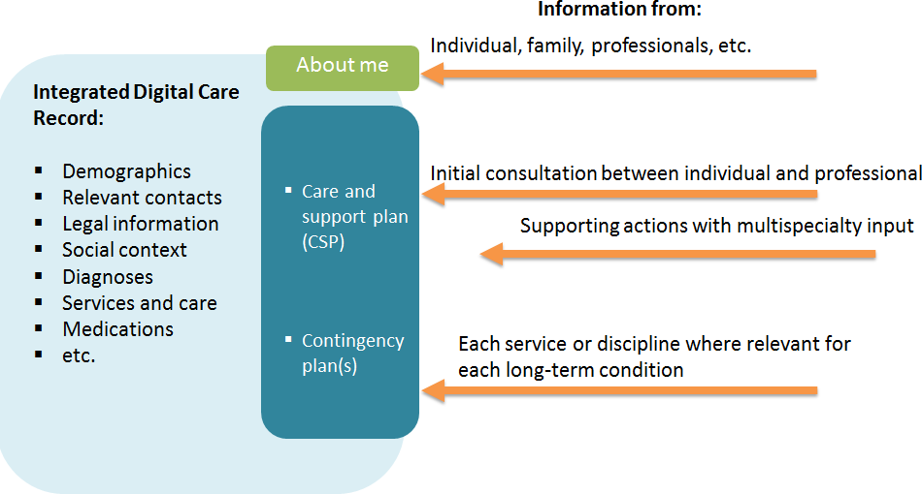

Relationship between ‘About Me’, Plans and main Record
Taken from the Digital Care and Support Planning Standard Report from the Professional Records Standards Body (PRSB).

